Slide 1
A common neural basis for contrast and motion coherence discrimination
Dan Birman
Frisem 2017-06-26

Slide 2
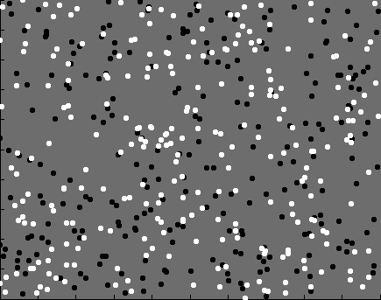

Slide 3
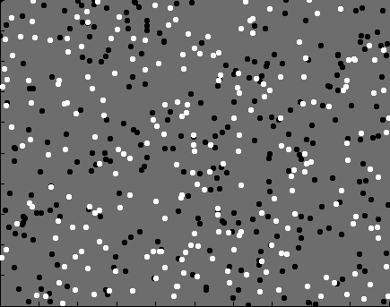

Slide 4
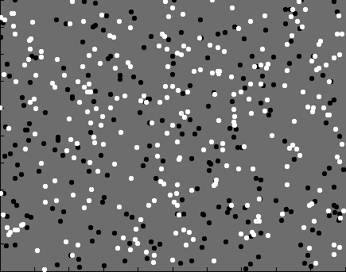

Slide 5
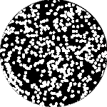

Slide 6
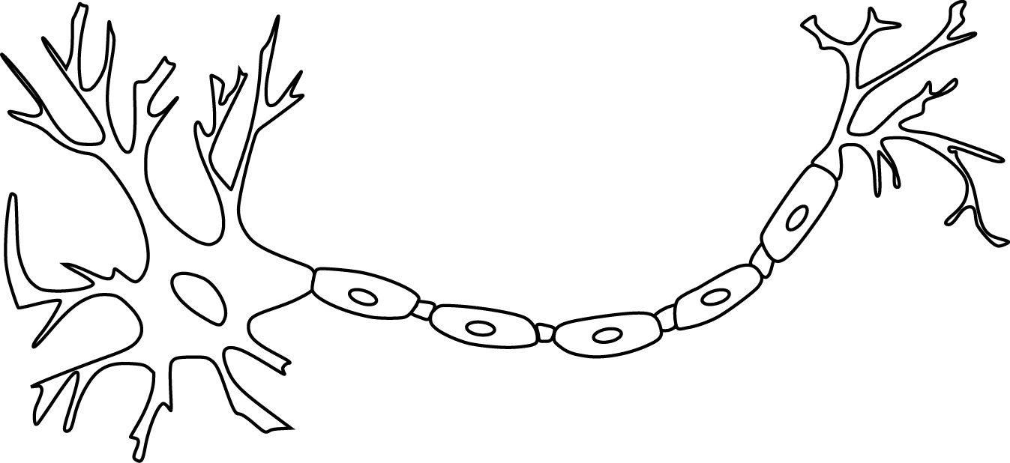

Slide 12
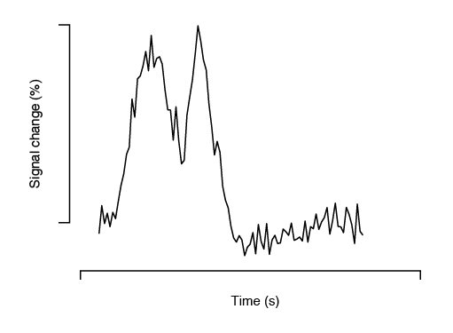

Slide 13
Encoding model of stimulus features

Slide 14
Encoding model of stimulus features
Encode contrast and motion coherence

Slide 15
Encoding model of stimulus features
Encode contrast and motion coherence
Compare to behavior (discrimination)

Slide 23
Fixation Task
11 observers, asynchronous fixation task
800+ trials (20 per experimental condition)
1 hr retinotopy
4 x 2 hr scanning sessions

Slide 24
Area V1
Area MT

Slide 25
Within-subject analysis:
Timecourses were averaged across ROIs
Deconvolution used to obtain per-condition timecourses

Slide 34
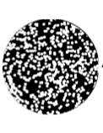
Encoding model of stimulus features
Encode contrast and motion coherence
Compare to behavior (discrimination)

Slide 35
Encoding model of stimulus features
Encode contrast and motion coherence
Compare to behavior (discrimination)

Slide 39
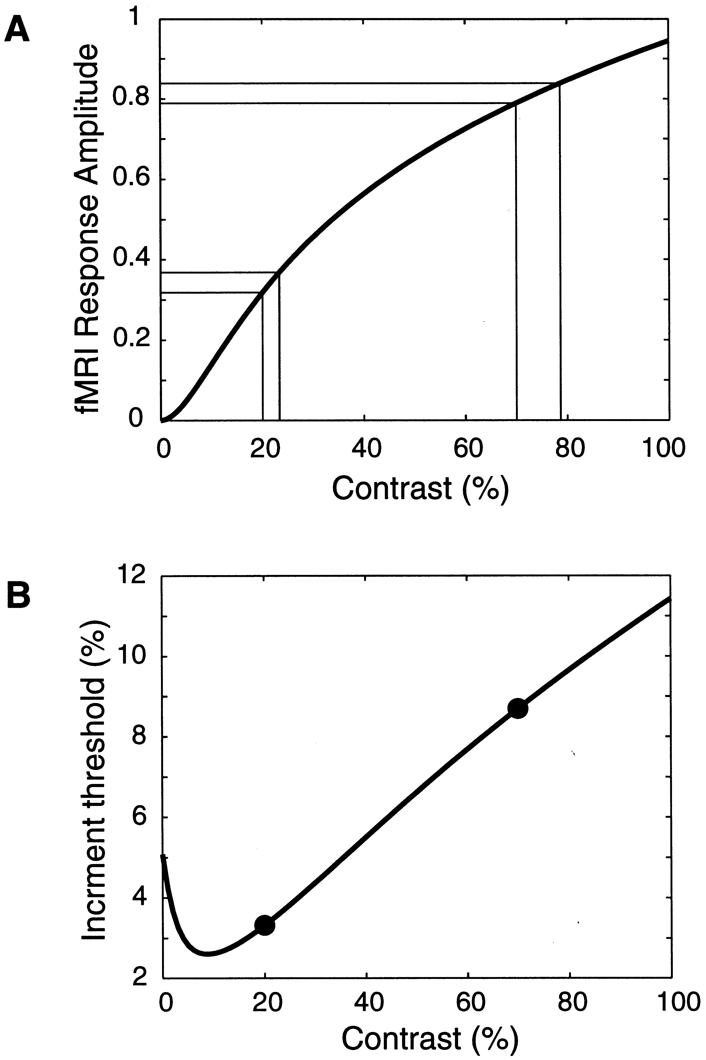
Boynton et al. 1999

Slide 42
Sensitivity = Response / Noise

Slide 47
A single encoding model can be used to
perform contrast and motion coherence discrimination

Slide 48

Thanks!
Justin Gardner

